Slide 1
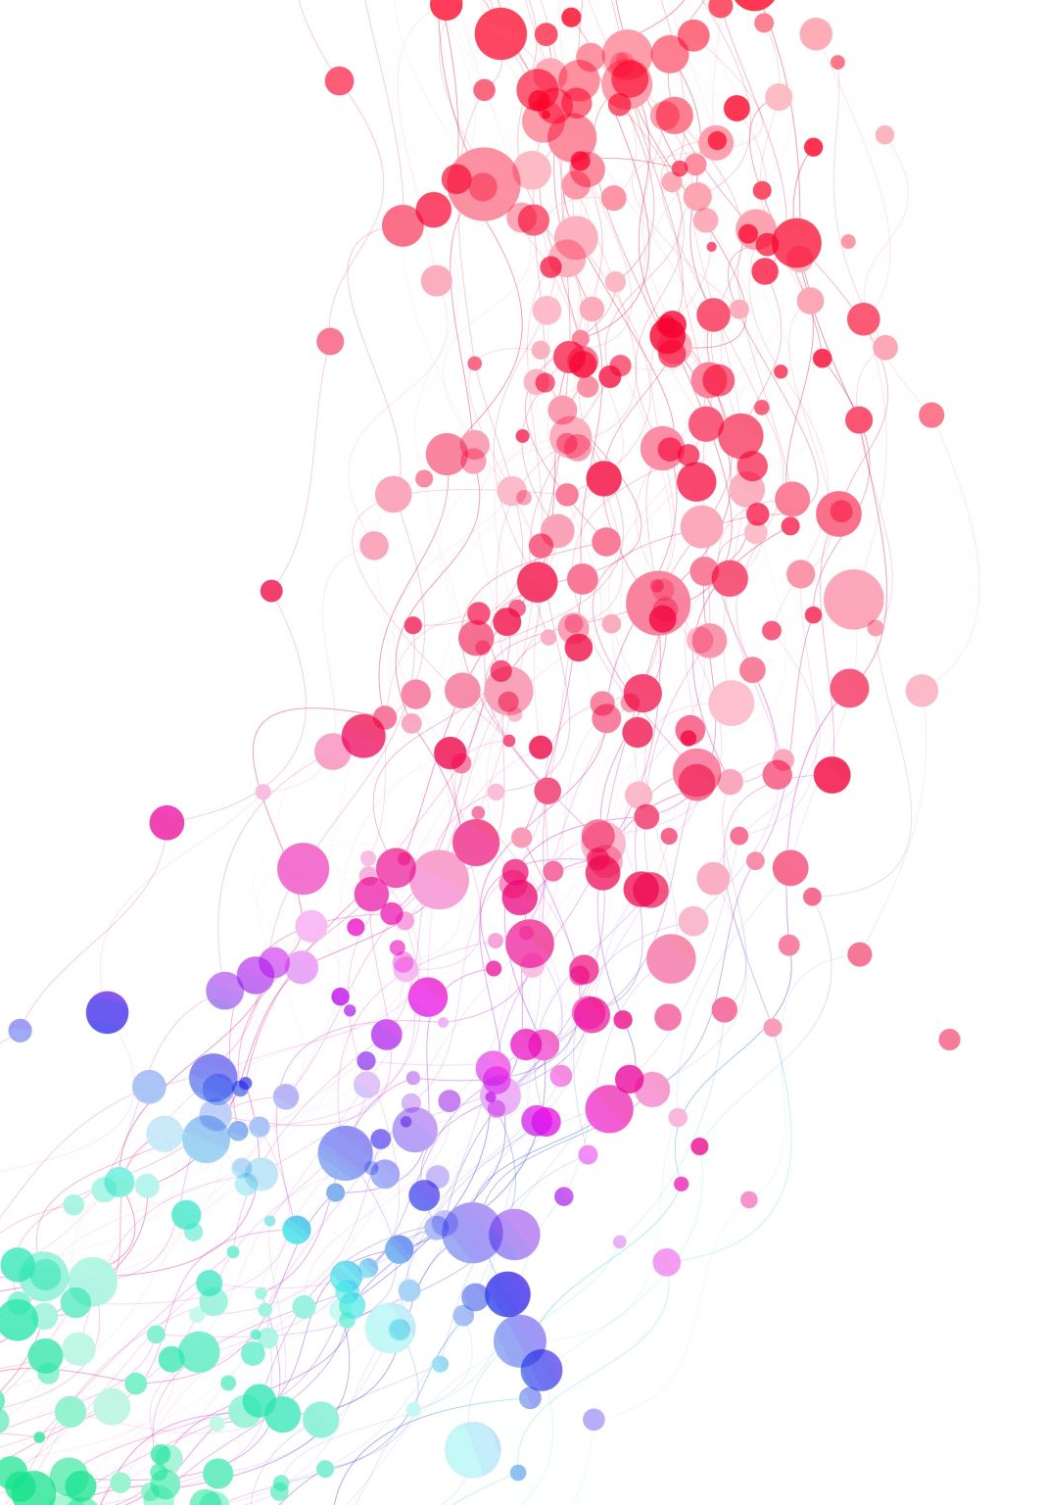
Web Presence Project
Crafting Compelling Web Presences
Sathana Jaya Mary | MBE11

Slide 2
Task : 1 Selection of Company
I have chosen Infosys as the company for this web presence project.
About Infosys:
Infosys Limited is a global leader in consulting, technology, outsourcing, and next-generation digital services. Founded in 1981 by N.R. Narayana Murthy and six other engineers in Pune, India, the company is headquartered in Bengaluru. Infosys offers services such as software development, business consulting, information technology, and AI-powered solutions across industries like banking, retail, manufacturing, and healthcare. It operates in over 50 countries and is known for its innovation, strong ethical standards, and commitment to sustainability. Infosys also plays a significant role in digital transformation and technological innovation worldwide.

Slide 3
Task : 2 Product and Service Description
Finacle is a banking software suite by Infosys that streamlines core banking operations and enhances digital banking capabilities.
Infosys Nia is an AI-driven platform that automates processes and provides data insights to optimize business operations and decision-making.
Infosys provides cloud computing services to help businesses scale and manage their IT infrastructure.
digital transformation services to innovate and optimize operations through advanced technology solutions.

Slide 4
Task:3 Platform analysis of the website
The website has been built with Adobe Experience Manager.
Tool used to Analyse: Wappalyzer.

Slide 5
Task : 4 Responsive Design Testing
“Navigate your next” Page is not much creative but loads smoothly on both mobile devices and PCs
“Infosys Knowledge Institute” is simple yet has more information.
The “Investors page” is my top pick on the website, as it provides extensive information on the latest updates from Infosys and features visually appealing images.
“Careers Page” loads seamlessly, but incorporating bold text and interactive features could further boost its engagement and visual impact.

Slide 6
Task : 5 Website Mistake Identification
Some javascripts should be minified to improve website performance by reducing file sizes and load times.
The page makes 56 requests, having more than 20 requests can lead to slower page loading times.
No Keyword were targeted in “about us” page.
No attractive images were found, adding more captivating images can significantly enhance the visual appeal for viewers and create a more engaging and immersive experience.

Slide 7
Task : 6 Website best practices list
Incorporate visually appealing images and optimize them for quicker loading times.
Ensure consistent text and font styles throughout the website to maintain a clean and professional appearance. This approach enhances readability and overall design cohesion.
Make user experience a top priority with smooth and easy-to-use menus.

Slide 8
Task: 7 Landing Page :
Landing Page URL : http://infylandingpage.liveblog365.com/

Slide 9
Thank YOU!!

